Slide 1
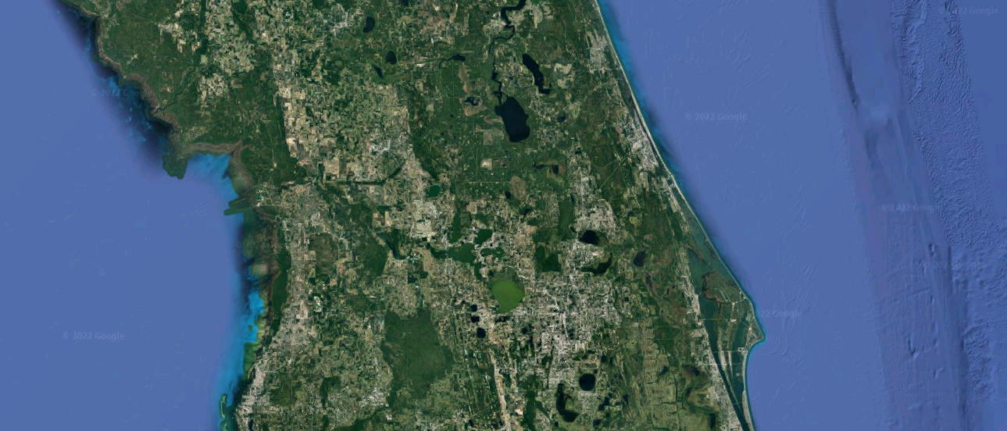
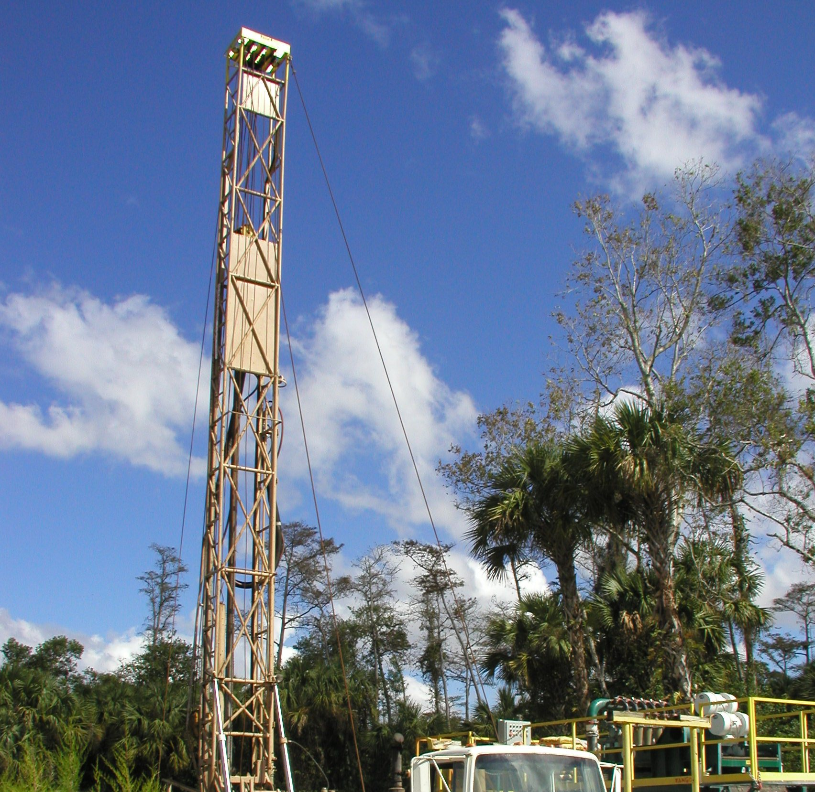
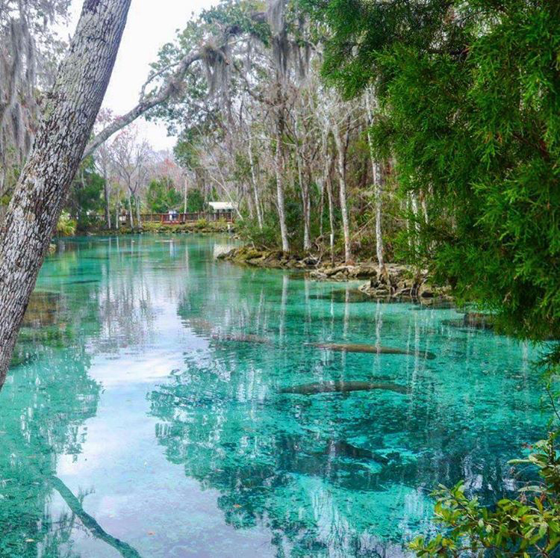
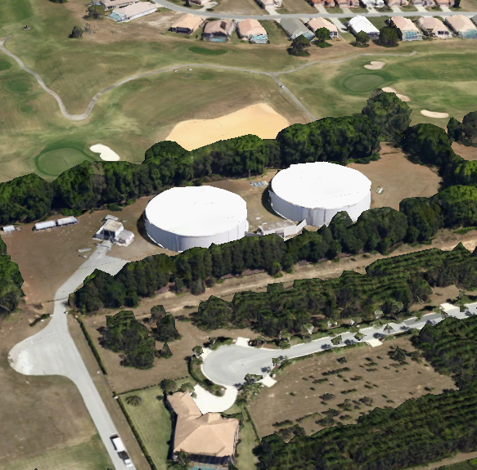

2024 Regional Water Supply Plan Update
May 20, 2026
Notes:
Good morning. Today we are presenting the final Regional Water Supply Plan Update for WRWSA. This effort was completed in coordination with member governments, utilities, and the Southwest Florida Water Management District to support long-term regional water supply planning.

Slide 2
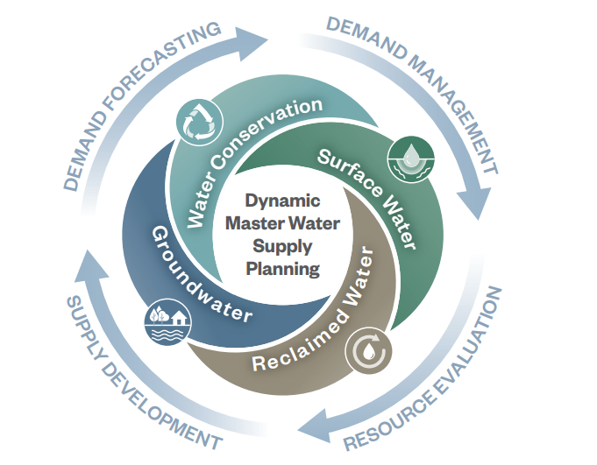
Project Goals and Objectives
Multi-county planning effort coordinating utilities across four counties
Goal
  Identify regional water supply opportunities
Objectives
  Quantify demand and assess conservation/reuse potential
  Identify available water resources to meet projected needs
  Support long-term regional coordination
Cooperatively funded by SWFWMD (2025 RWSP, Northern Region)
Next Step: Final Report Adoption
Notes:
This was a multi-county planning effort focused on identifying long-term regional water supply opportunities across Citrus, Hernando, Marion, and Sumter Counties.
The primary goals were to:
update regional demand projections,
evaluate conservation and reclaimed water opportunities,
assess available water resources,
and support long-term regional coordination.
The plan was cooperatively funded with SWFWMD in support of the 2025 Northern Region RWSP update.
Today’s requested action is adoption of the final report

Slide 3
Demand Projection Overview
Forecasts developed using WMD, utility planning data and master plans
Population growth remains primary demand driver
Conservation and reclaimed water influence future demand trends
Notes:
Regional demands are projected to continue increasing through 2045, primarily driven by population growth.
The forecasts were developed using District data, utility planning information, and utility master plans.
The projections also incorporate conservation and reclaimed water assumptions, which help moderate future potable demand growth over time.
Overall regional demand increases from approximately 170 MGD in 2020 to approximately 237 MGD by 2045.

Slide 4
Reclaimed Water & Reuse Assumptions
Reuse assumptions based on utility planning and survey data
Beneficial reuse projected to increase by ~20 MGD by 2045
Remaining non-beneficial reuse may support future regional supply opportunities
Notes:
This slide summarizes the reclaimed water assumptions incorporated into the planning analysis.
The projections are based on utility planning information and utility survey responses.
Beneficial reuse is projected to increase by approximately 20 MGD by 2045, reflecting planned reuse expansion across the region.
At the same time, a substantial volume of non-beneficial reuse remains available regionally, which may represent future opportunities for recharge, reuse expansion, and alternative water supply development.

Slide 5
Regional Supply Opportunities
Strategic Takeaways
Near-Term Opportunities
  Conservation and reuse provide highest value at lowest cost
  Regional reuse expansion and recharge may help offset future demands
Mid-to-Long-Term Options
  MAR and Lower Floridan Aquifer development provide additional supply diversification
  Surface water and desalination preserve long-term resiliency options
Project Triggers
  Demand approaching permitted withdrawal limits
  UFA constraints or completed feasibility studies
Notes:
This slide summarizes the major regional supply strategies evaluated as part of the planning effort.
In the near term, conservation and non-potable reuse expansion provide the greatest value at the lowest cost.
Mid-to-long-term opportunities include managed aquifer recharge, Lower Floridan Aquifer development, and regional aquifer recharge concepts.
Surface water and desalination remain important long-term resiliency options if future supply constraints emerge.
The chart on the right compares relative unit costs across potential projects and highlights the importance of phased implementation and diversification over time.

Slide 6
Recommendation Summary
Near-Term
0-10 Years
MAR feasibility studies (Hernando & Citrus)
Mid-Term
10-20 Years
LFA wellfield development and aquifer recharge
Advance LFA feasibility and recharge evaluation
Long-Term
20+ Years
Surface water and desalination options
Ongoing
Expand regional monitoring and data integration
Initiate Tier 3 conservation support and NPR regional expansion
Preserve future supply diversification opportunities
Support conservation, NPR expansion, and adaptive management
Phasing Logic: 1) Prioritize low-cost conservation and recharge opportunities,
2) diversify supplies as constraints emerge, and 3) preserve long-term resiliency options.
Notes:
The report recommends a phased regional planning strategy.
In the near term, the focus is on managed aquifer recharge feasibility studies, conservation, and regional reuse expansion.
In the mid term, the focus shifts toward Lower Floridan Aquifer feasibility and aquifer recharge opportunities.
Long-term options include preservation of future surface water and desalination opportunities if needed.
The overall phasing logic is to:
prioritize lower-cost conservation and recharge opportunities first,
diversify supplies as constraints emerge,
and 3) preserve long-term resiliency options.

Slide 7

Key Take Aways + Requested Board Action
Key Takeaways
Requested Board Action
Regional demands continue increasing
Conservation/reuse remain important
Regional coordination is critical
Adaptive management recommended
  Track UFA levels, spring flows, and reclaimed water trends
  Reassess MAR/LFA feasibility as conditions evolve
  Integrate climate and growth projections into future plans
Adopt Final RWSP Update
Notes:
In summary:
regional demands are expected to continue increasing,
conservation and reclaimed water remain important planning tools,
and regional coordination remains critical to long-term resiliency.
The report also recommends continued monitoring and adaptive management, including tracking groundwater conditions, reclaimed water trends, and reassessing future supply feasibility as conditions evolve.
The requested Board action today is adoption of the Final Regional Water Supply Plan Update.

Slide 8
Thank you!
Questions & Discussion
Notes:
Thank you. We’d be happy to answer any questions.

